Slide 1

AgriVision
Syed Wameez Ahmed 160923733067
Mohd Zaid Khan 160923733073
Mohammed Abdul Muheed 160923733076
Ali Abbas Masum Khoja 160923733101

Slide 2
Introduction
🌱 WHAT IT IS
• A full-stack mobile platform engineered specifically for Indian agriculture.
• Provides a digital marketplace where farmers can list and sell their agricultural produce.
• Integrates government subsidies, weather updates, agricultural news and live mandi prices.
• Offers satellite-based crop health monitoring to help farmers observe their agricultural land.
⚡ WHAT IT DOES
• Enables farmers to list agricultural products and buyers to discover and purchase produce directly.
• Provides information about government agricultural schemes and allows farmers to access application information.
• Uses satellite imagery to observe agricultural fields and identify potential vegetation changes and crop stress indicators.
• Provides mandi prices to help farmers understand current market rate
👥 WHO IT IS FOR
• Smallholder Farmers: Maximize profits by selling directly at verified rates.
• Agricultural Buyers: Wholesalers, retailers, and restaurants sourcing directly from farms.
• Farming Cooperatives (FPOs): Aggregate harvest volumes and track regional demand.
KEY IMPACT HIGHLIGHTS: Zero Middleman Cuts | Integrated Agricultural Information | Native Support in 4 Regional Languages

Slide 3
Problem Statement
01 | Limited Field Visibility
Large agricultural fields are difficult to inspect regularly through physical visits alone. Smaller or developing problem areas can easily go unnoticed
🛑 Key Issue: Limited aerial visibility and time-consuming manual inspection.
02 | Water and Crop Stress
Different areas of agricultural fields may experience variations in vegetation conditions and crop stress. Identifying these changes through occasional physical visits can be challenging.
🛑 Key Issue: Farmers lack accessible tools for monitoring field consitions
03 | Fragmented Agricultural Information
Farmers depend on separate sources for weather, mandi prices, government schemes, crop information, field monitoring and buyer discovery.
🛑 Key Issue: Critical information is scattered across disconnected services
04 | Lack of Timely Decision Support
Even when agricultural information is available, it is not always presented together when farmers need to make decisions about their fields and crops.
🛑 Key Issue: Farmers lack a unifies view for timely agricultural decisions

Slide 4
Project Objectives
1
PROVIDE DIRECT MARKET ACCESS
Create a digital marketplace where farmers can list their agricultural produce and connect with potential wholesale, retail and institutional buyers.
2
INTRODUCE SATELLITE-BASED FIELD MONITORING
Use available satellite imagery to observe vegetation patterns and changes across agricultural fields.
The purpose is to provide a broad monitoring layer and identify areas that may require closer inspection.
3
INTEGRATE ACCESS TO GOVERNMENT SCHEMES & SUBSIDIES
Provide farmers with information about government agricultural schemes and subsidies, enabling them to explore available benefits and access application details directly through the platform.
4
INTEGRATE ESSENTIAL AGRICULTURAL INFORMATION
Bring together weather forecasts, agricultural news, live mandi prices and crop monitoring information to help farmers make informed agricultural and selling decisions.
5
BRIDGE THE DIGITAL DIVIDE
Provide a simple mobile interface with regional-language support so that farmers can access agricultural information without navigating multiple complicated platforms.

Slide 5
Existing Solutions & Critical Limitations
🏛️ EXISTING METHODS & WORKFLOW
• Physical Field Inspection: Farmers and agricultural workers manually inspect fields to identify crop and irrigation issues.
• Satellite-based monitoring: Satellite imagery is used to monitor agricultural fields and vegetation.
• Digital Agricultural Marketplace : Online platforms provide opportunities for farmers to list produce and connect with potential buyers.
• Mandi & Agricultural Information: Market platforms and local agricultural sources provide prices, crop information and farming advice.
⚠️ CRITICAL LIMITATIONS
✖ Manual Inspection: Large fields require significant time and labour for repeated inspection.
✖ Limited Monitoring Detail: Satellite imagery can be affected by cloud cover and may lack close-range field detail.
✖ Fragmented Services: Drone services, market information, weather and agricultural advice often operate separately.
✖ Limited Decision Support: Raw agricultural and market information is not automatically converted into simple, farmer-facing decisions.
CONCLUSION: Existing agricultural solutions provide useful data and services, but remain fragmented, labour-intensive, and difficult to convert into timely farmer decisions.

Slide 6
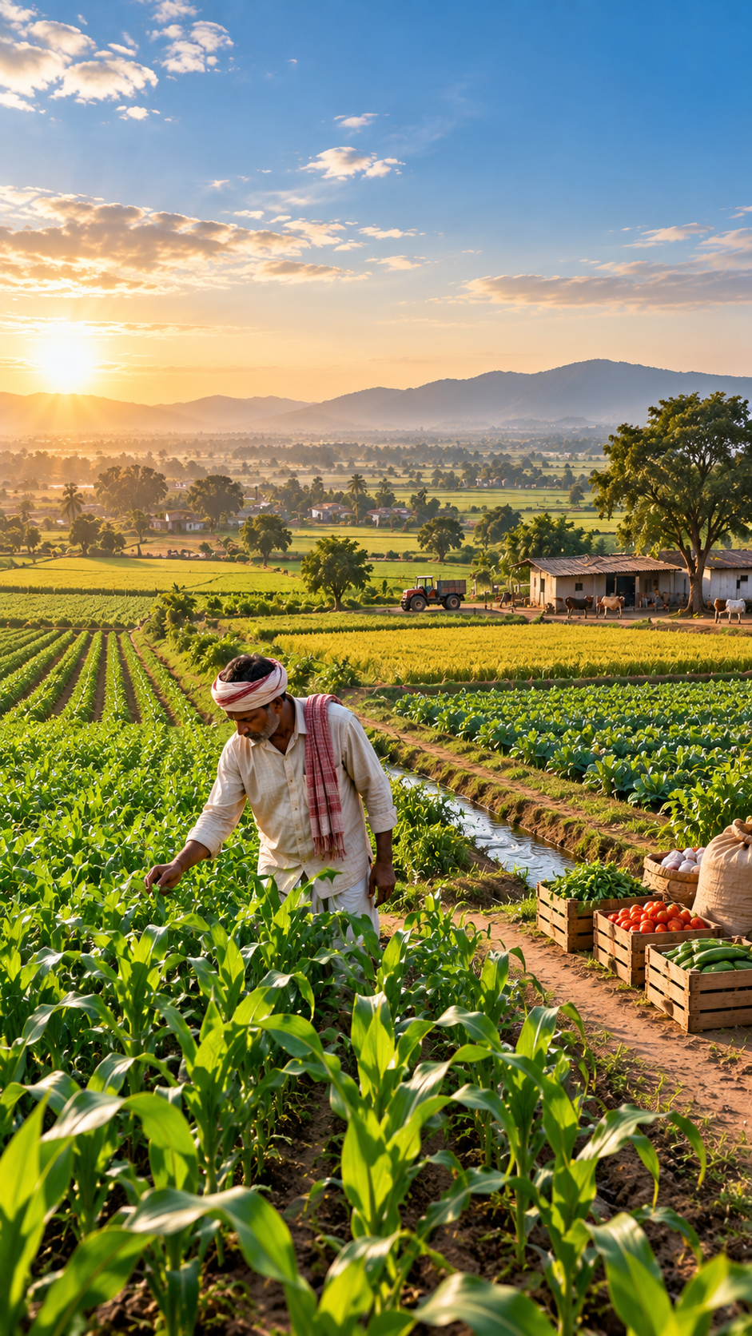
Proposed Solution: AgriVision
✓ Direct Farmer to Buyer Marketplace
Connects farmers with potential buyers through digital produce listings.
✓ Digital Produce Discovery
Enables buyers to discover and filter available agricultural products based on crop, quantity, location and other listing information
✓ Satellite based Field Monitoring
Uses available satellite observations to monitor registered agricultural areas and observe vegetation patterns over time.
✓ Government Schemes & Subsidies
Provides farmers with access to government agricultural schemes, subsidy information and application details through a centralized platform.

Slide 7
Proposed Solution: AgriVision
✓ Field Stress & Priority Mapping
Converts collected imagery into a simple field report highlighting temperature variation, potential stress zones and areas requiring closer inspection.
✓ Weather and Environmental Intelligence
Combines field information with weather forecasts and environmental data to provide context for agricultural decisions.
✓ Real-time Mandi Price Intelligence
Brings mandi prices into the platform so farmers can compare market conditions before deciding where and when to sell.
✓ Buyer Demand & Selling Decision
Combines buyer demand, produce listings, mandi prices and field information into one workflow.

Slide 8
System Workflow
STEP 1
STEP 2
STEP 3
STEP 4
STEP 5
STEP 6
User Onboarding
Select Farmer or Buyer role via Clerk Auth with phone/email credentials.
KYC & Farm Setup
Farmer submits location coordinates, farm size, and verified documents.
Crop Health Scan
Capture crop photo for instant AI disease assessment & soil readings.
Market Intelligence
Query live AGMARKNET mandi rates and review Gemini AI sell advice.
Produce Listing
List harvested crops with expected price, quantity, and quality tiers.
Buyer Discovery
Buyers filter produce, view farm maps, and finalize direct purchase.
➔
➔
➔
➔
➔
TOTAL CYCLE TIME: Less than 3 minutes to diagnose crops, check rates, and broadcast produce to verified regional buyers.

Slide 9
Key System Features
1. Farmer-to-Buyer Marketplace
Connects farmers with potential buyers through digital produce, listings, reducing dependence on traditional intermediaries.
2. Digital Produce Discovery
Enables buyers to explore available agricultural products, view product details and discover produce listed by farmers.
3. Product management
Allows farmers to manage their listed products while buyers can explore verifies farmer profiles and their available produce.
4. Government Schemes & Subsidies
Provides information about government agricultural schemes, subsidies, eligibility and application procedures.
5. Satellite-based Crop Health Monitoring
Uses satellite imagery to monitor registered agricultural land and observe vegetation conditions and potential crop stress indicators.
6. Weather Information & Forecasts
Provides weather conditions and forecasts to help farmers plan their agricultural activities.
7. Live Mandi Price Intelligence
Provides agricultural commodity prices from mandis to help farmers understand market rates and make better selling decisions.
8. Agricultural News & Updates
Keeps farmers informed about agricultural developments, government announcements and relevant farming news.

Slide 10
Before & After Comparison
❌ BEFORE: CONVENTIONAL WORKFLOW
• Market Access: Farmers often depend on intermediaries to sell their agricultural produce.
• Field Monitoring: Farmers rely heavily on physical inspections to observe agricultural field conditions.
• Information Access: Government schemes, weather, news and mandi prices are available through separate sources.
• Product Discovery: Buyers may find it difficult to discover available agricultural produce & connect with farmers.
• Decision Making: Farmers must combine information from multiple sources before deciding what action take.
✓ AFTER: WITH AGRIVISION PLATFORM
• Direct Market Access: Farmers can list their products and connect directly with buyers through the digital marketplace.
• Crop Monitoring: Satellite-based observations provide information about vegetation conditions and potential crop stress.
• Integrated Information:Subsidies, weather, news and mandi prices are accessible through one platform.
• Product Discovery: Buyers can explore agricultural products and view verified farmer profiles.
• Better Decision making: Access to integrated agricultural and market information helps farmers make informed decisions.
OVERALL IMPROVEMENT: From fragmented, manual agricultural monitoring to integrated, data-supported decision making with AgriVision.

Slide 11
Technology Stack & Architecture
FRONTEND & MOBILE UI
React Native & Expo
TypeScript, React Navigation 7, Lucide Icons, and React Native Safe Area Context powering responsive Android & iOS interfaces.
STATE & LOCALIZATION
React Query & i18next
TanStack React Query for async caching, i18next for multi-language localization (EN, HI, TE, TA), and Expo SecureStore.
BACKEND & DATABASE
Supabase & PostgreSQL
PostgreSQL relational database with Row Level Security (RLS), Supabase Cloud Storage for crop photos, and Edge Functions.
AUTHENTICATION
Clerk Expo & JWT
Secure session tokens and role-based access control (Farmer / Buyer / Admin) synced directly with database profiles.
SATELLITE IMAGERY
Satellite-based field observation
Uses available satellite imagery and vegetation-related observations to monitor registered agricultural areas and identify potential changes in crop conditions.
AGRONOMIC DATA APIS
Data.gov.in & Open-Meteo
Official AGMARKNET mandi price feeds, Open-Meteo keyless weather/soil telemetry, and OpenStreetMap Nominatim geocoding.

Slide 12
Business & Revenue Model
100% FREE CORE
B2B SAAS PLAN
FREIGHT TIE-UPS
SPONSORED HUB
PAID PDF AUDITS
Freemium Core for Farmers
Smallholder farmers access essential disease scanning, mandi rates, weather alerts, and product listings for free to maximize rural adoption.
💰 Zero Fees on Farmers
Institutional Buyer Subscriptions
Wholesale food processors, retail chains, and bulk traders pay a monthly subscription for verified farmer catalogs, bulk leads, and priority sourcing.
💰 Monthly B2B SaaS Tier
Logistics Referral Commission
AgriVision partners with local rural freight and trucking providers, earning a 2-4% referral commission on booked produce transport trips.
💰 2% to 4% Referral Cut
Certified Agri-Input Listings
Verified vendors of organic fertilizers, hybrid seeds, and micro-irrigation tools pay for featured showcase listings inside the farmer advisory portal.
💰 Pay-Per-Featured Slot
Commercial Farm Audits
Commercial plantations pay for downloadable certified agronomic health audit PDFs, export quality compliance logs, and historical canopy reports.
💰 ₹199 - ₹499 Per Export Audit

Slide 13
Future Scope & Strategic Roadmap
PHASE 1 (SHORT TERM)
★ Enhanced Crop Health Monitoring
Improve crop-condition analysis using higher-resolution imagery, vegetation indicators and thermal data for more precise field assessment
PHASE 1 (SHORT TERM)
★ Expanded Satellite & Data Integration
Integrate additional satellite sources and improve field-monitoring capabilities to provide more consistency.
PHASE 2 (MID TERM)
★ Predictive Crop Risk Analysis
Use historical field, weather and environmental data to identify emerging crop-stress risks and support earlier intervention.
PHASE 2 (MID TERM)
★ Regional Voice & Language Assistance
Introduce voice-based agricultural assistance with support for more Indian regional languages and farmer-friendly interaction.
PHASE 3 (LONG TERM)
★ Precision Farm Recommendations
Extend field intelligence into crop-specific recommendations for irrigation, inspection and other farm-management activities.
PHASE 3 (LONG TERM)
★ Connected Smart Agriculture Ecosystem
Connect field intelligence, weather, markets, buyers and farm data into a unified ecosystem for end-to-end agricultural decision support.
MISSION: EMPOWERING FARMERS WITH ACCESSIBLE, DATA-DRIVEN & INTELLIGENT AGRICULTURAL DECISIONS

Slide 14
THANK YOU

